Slide 1


Data Structures & Algorithms for Interviews
Vignesh Narayanan

Slide 2


Slide 3
Agenda
Time vs Space Complexity (The never ending war)
Arrays
Stacks
Queues
if time permits
Linked Lists;
else
Will be covered in tutoring session 2 next week;

Slide 4
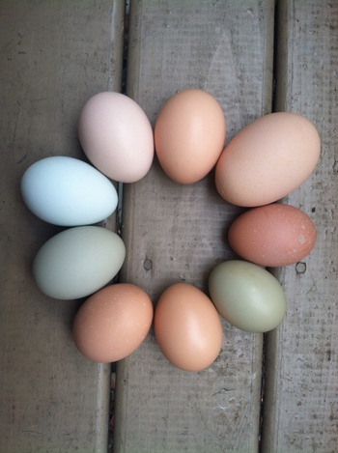

9 egg puzzle ?
A friend gives you 9 eggs -- 8 are 10 oz., but 1 is not.
The friend also gives you a very accurate balance and tells you to determine the odd egg out.
How would you do that ?
Analogies to
Time & Space
Complexities ?
Completeness vs.
Optimality ?

Slide 5
ABC of programming interview
Ask
Before
Coding

Slide 6


Slide 7
Find the repeating and the missing
Given an array where one number in it is missing and one number occurs twice. Find these two numbers.
Questions:
Size ?
Range ?
Sorted ?
Multiple duplicate elements ?

Slide 8
More refined problem statement
Given an unsorted array of size n. Array elements are in range from 1 to n. One number from set {1, 2, …n} is missing and one number occurs twice in array. Find these two numbers.
Now solutions ?

Slide 9
Method 1 (Use Sorting)
1) Sort the input array. 2) Traverse the array and check for missing and repeating.
Time Complexity: O(nLogn)
Method 2 (Use count array)
1) Create a temp array temp[] of size n with all initial values as 0. 2) Traverse the input array arr[], and do following for each arr[i] ……a) if(temp[arr[i]] == 0) temp[arr[i]] = 1; ……b) if(temp[arr[i]] == 1) output “arr[i]” //repeating 3) Traverse temp[] and output the array element having value as 0 (This is the missing element)
Time Complexity: O(n) Auxiliary Space: O(n)

Slide 10
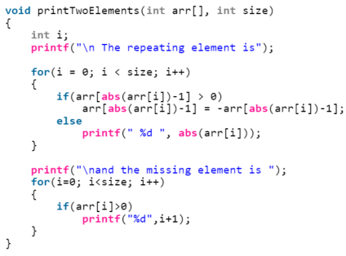
Can you do better ? (PS: Interviewers favorite sentence!)
While traversing the array, use absolute value of every element as index and make the value at this index as negative to mark it visited.
If something is already marked negative then this is the repeating element.
To find missing, traverse the array again and look for a positive value.

Slide 11
Find the maximum repeating number
Given an array of size n, the array contains numbers in range from 0 to k-1 where k is a positive integer and k <= n. Find the maximum repeating number in this array.

Slide 12
The naive approach:
Run two loops, the outer loop picks an element one by one, the inner loop counts number of occurrences of the picked element.
Finally return the element with maximum count.
Time complexity of this approach is O(n^2).
A better approach:
Create a count array of size k and initialize all elements of count[] as 0.
Iterate through all elements of input array, and for every element arr[i], increment count[arr[i]].
Finally, iterate through count[] and return the index with maximum value.
This approach takes O(n) time, but requires O(k) space.

Slide 13
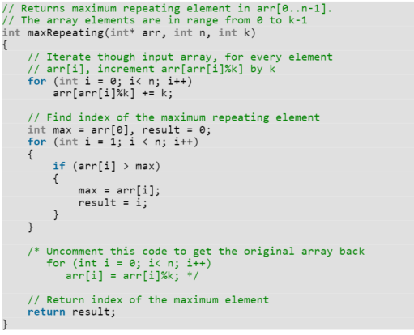
Can we do better ?
Iterate though input array arr[], for every element arr[i], increment arr[arr[i]%k] by k
Find the maximum value in the modified array.
Index of the maximum value is the maximum repeating element.
If we want to get the original array back, we can iterate through the array one more time and do arr[i] = arr[i] % k where i varies from 0 to n-1.

Slide 14
Similar problems
Find the Missing Number: You are given a list of n-1 integers and these integers are in the range of 1 to n. There are no duplicates in list. One of the integers is missing in the list. Write an efficient code to find the missing integer.
Find the Number Occurring Odd Number of Times: Given an array of positive integers. All numbers occur even number of times except one number which occurs odd number of times. Find the number in O(n) time & constant space.
XOR !

Slide 15
Find the smallest missing number
Given a sorted array of n integers where each integer is in the range from 0 to m-1 and m > n. Find the smallest number that is missing from the array.
Example:
Input: {0, 1, 2, 6, 9}
n = 5
m = 10 Output: 3

Slide 16
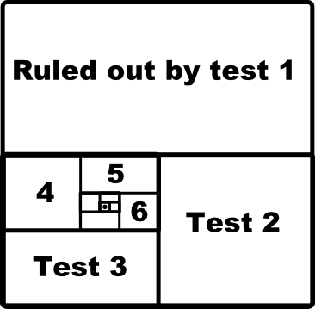
Newton's law of programming interview !
If you can find a linear time O(n) algorithm by yourself during an interview, then there exists (mostly always) a logarithmic time O(log n) algorithm that the interviewer expects from you !
Binary Search !

Slide 17
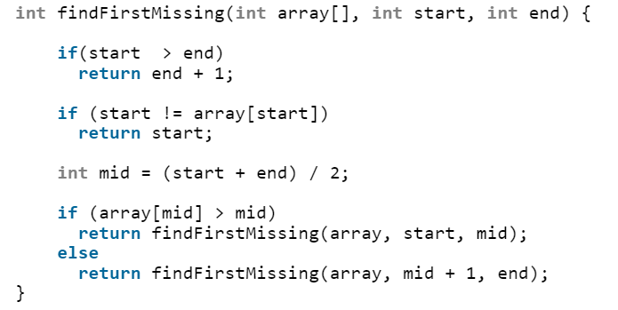
1) If the first element is not same as its index then return first index …2) Else get the middle index say mid …………a) If arr[mid] greater than mid then the required element lies in left half. …………b) Else the required element lies in right half.

Slide 18
Similar Problems
Count the number of occurrences in a sorted array: Given a sorted array arr[] and a number x, write a function that counts the occurrences of x in arr[].
Find the maximum element in an array which is first increasing and then decreasing: Given an array of integers which is initially increasing and then decreasing, find the maximum value in the array.
Search an element in a sorted and rotated array: An element in a sorted array can be found in O(log n) time via binary search. But suppose we rotate an ascending order sorted array at some pivot unknown to you beforehand. So for instance, 1 2 3 4 5 might become 3 4 5 1 2. Devise a way to find an element in the rotated array in O(log n) time.

Slide 19

What we learnt so far ?

Slide 20
Find pair that sums up to a given number
Given an array A[] of n numbers and another number x, determine whether or not there exist two elements in S whose sum is exactly x.
Naive? Run 2 loops

Slide 21
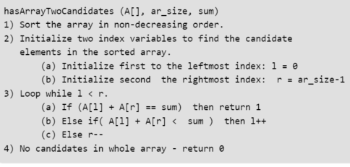
Time Complexity: Depends on what sorting algorithm we use. If we use Merge Sort or Heap Sort then (nlogn) in worst case. If we use Quick Sort then O(n^2) in worst case.
Auxiliary Space : Again, depends on sorting algorithm. For example auxiliary space is O(n) for merge sort and O(1) for Heap Sort.

Slide 22


Slide 23
Similar Problems
Find a pair with the given difference: Given an unsorted array and a number n, find if there exists a pair of elements in the array whose difference is n.
Find a triplet that sum to a given value: Given an array and a value, find if there is a triplet in array whose sum is equal to the given value. If there is such a triplet present in array, then print the triplet and return true. Else return false. For example, if the given array is {12, 3, 4, 1, 6, 9} and given sum is 24, then there is a triplet (12, 3 and 9) present in array whose sum is 24.
Pythagorean Triplet in an array: Given an array of integers, write a function that returns true if there is a triplet (a, b, c) that satisfies a² + b² = c².

Slide 24
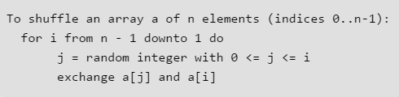
Shuffle a given array
Fisher–Yates shuffle Algorithm works in O(n) time complexity. The assumption here is, we are given a function rand() that generates random number in O(1) time.
The idea is to start from the last element, swap it with a randomly selected element from the whole array (including last). Now consider the array from 0 to n-2 (size reduced by 1), and repeat the process till we hit the first element.

Slide 25
Rearrange positive and negative numbers
An array contains both positive and negative numbers in random order. Rearrange the array elements so that positive and negative numbers are placed alternatively. Number of positive and negative numbers need not be equal. If there are more positive numbers they appear at the end of the array. If there are more negative numbers, they too appear in the end of the array.
For example, if the input array is [-1, 2, -3, 4, 5, 6, -7, 8, 9], then the output should be [9, -7, 8, -3, 5, -1, 2, 4, 6]

Slide 26
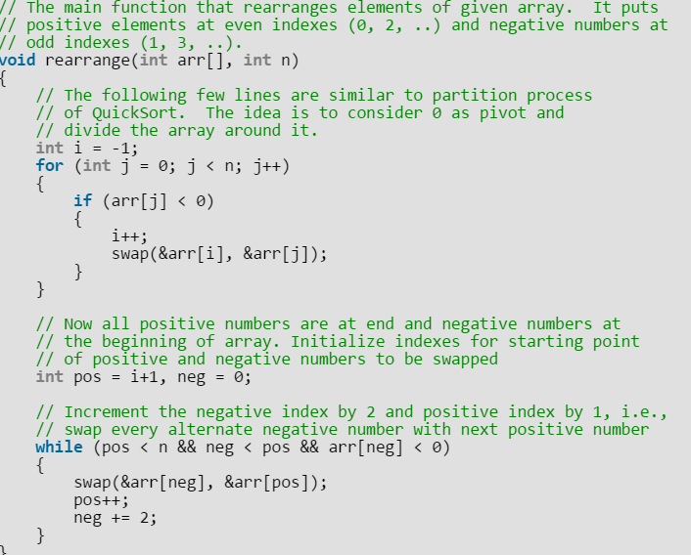
The solution is to first separate positive and negative numbers using partition process of QuickSort.
In the partition process, consider 0 as value of pivot element so that all negative numbers are placed before positive numbers.
Once negative and positive numbers are separated, we start from the first negative number and first positive number, and swap every alternate negative number with next positive number.

Slide 27
Rearrange positive and negative numbers (Variation)
Given an array of positive and negative numbers, arrange them in an alternate fashion such that every positive number is followed by negative and vice-versa maintaining (preserving) the input order of appearance.
Example:
Input: arr[] = {1, 2, 3, -4, -1, 4}
Output: arr[] = {-4, 1, -1, 2, 3, 4}

Slide 28
The idea is to process array from left to right.
While processing, find the first out of place element in the remaining unprocessed array.
An element is out of place if it is negative and at odd index, or it is positive and at even index.
Once we find an out of place element, we find the first element after it with opposite sign.
We right rotate the sub array between these two elements (including these two).

Slide 29
Similar Problems
Segregate Even and Odd numbers: Given an array A[], write a function that segregates even and odd numbers. The functions should put all even numbers first, and then odd numbers.
Example: Input = {12, 34, 45, 9, 8, 90, 3} Output = {12, 34, 8, 90, 45, 9, 3}
Segregate 0s and 1s in an array: You are given an array of 0s and 1s in random order. Segregate 0s on left side and 1s on right side of the array. Traverse array only once.
Example:
Input array = [0, 1, 0, 1, 0, 0, 1, 1, 1, 0]
Output array = [0, 0, 0, 0, 0, 1, 1, 1, 1, 1]

Slide 30
Problems that uses 2 input arrays
Input array’s are mostly sorted
See if you can use the merge phase of the merge sort

Slide 31
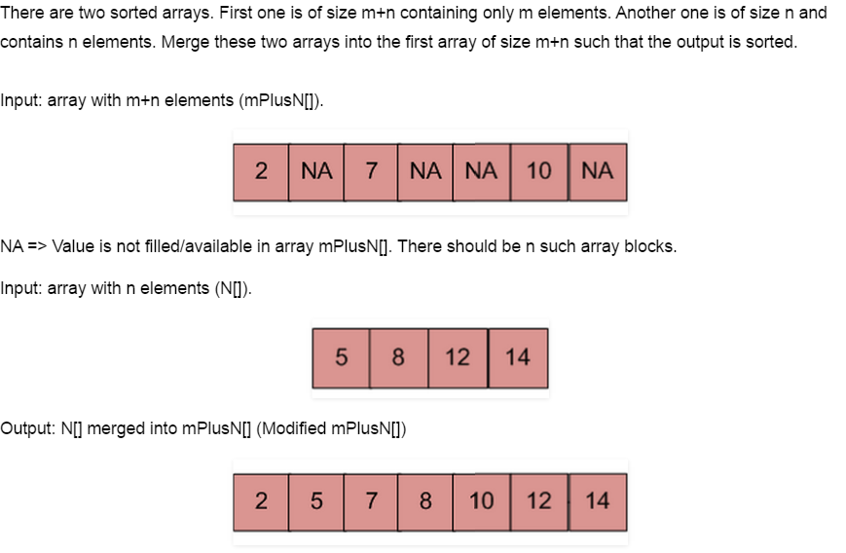
Merge an array of size n into another array of size m+n

Slide 32
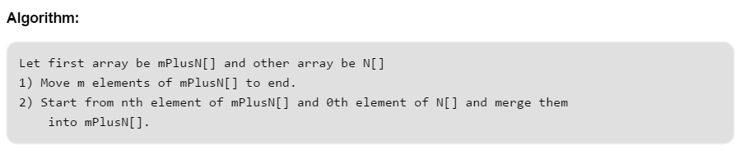

Slide 33
Median of two sorted arrays
There are 2 sorted arrays A and B of size n each. Write an algorithm to find the median of the array obtained after merging the above 2 arrays(i.e. array of length 2n).

Slide 34
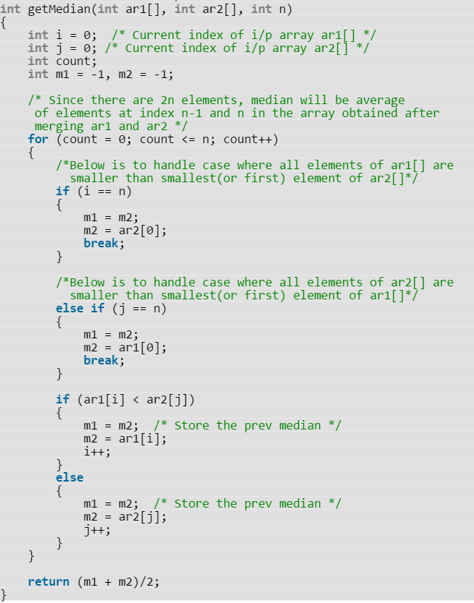
Method 1 (Simply count while Merging) Use merge procedure of merge sort. Keep track of count while comparing elements of two arrays. If count becomes n(For 2n elements), we have reached the median. Take the average of the elements at indexes n-1 and n in the merged array.

Slide 35
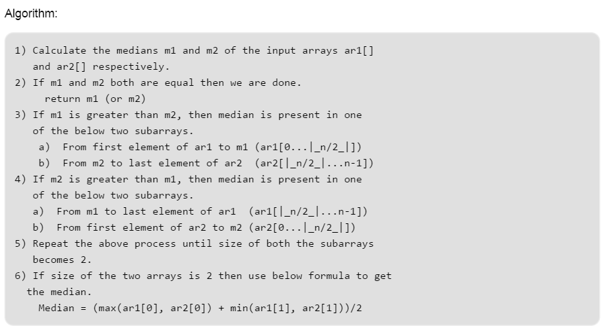
Method 2 (By comparing the medians of two arrays)

Slide 36
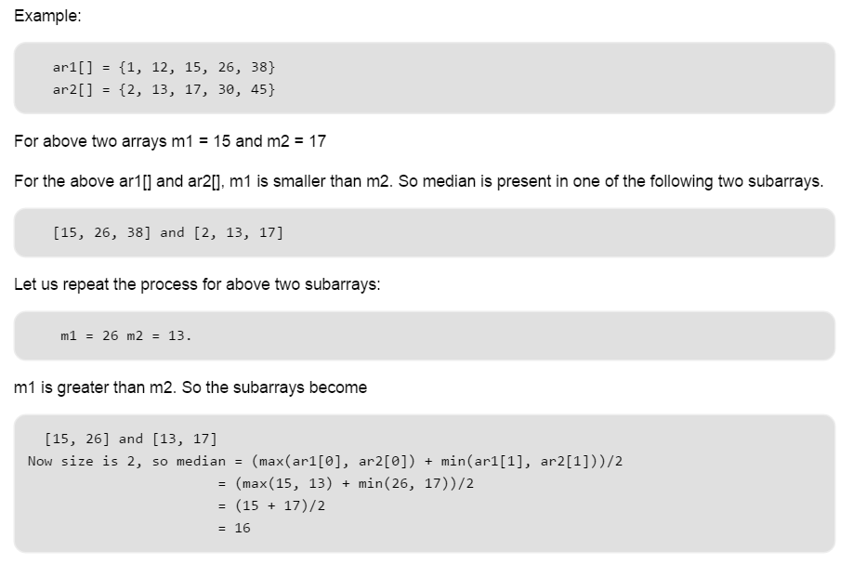

Slide 37
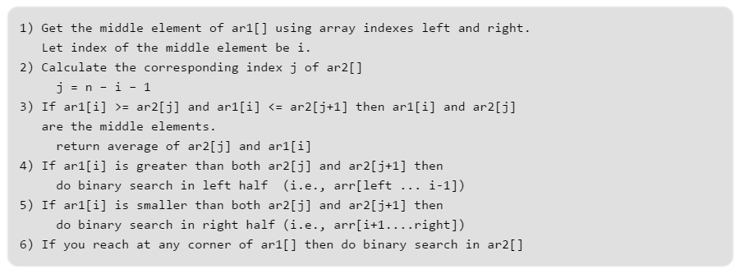
Method 3 (By doing binary search for the median):

Slide 38
Example:
ar1[] = {1, 5, 7, 10, 13}
ar2[] = {11, 15, 23, 30, 45}
Middle element of ar1[] is 7.
Let us compare 7 with 23 and 30, since 7 smaller than both 23 and 30, move to right in ar1[].
Do binary search in {10, 13}, this step will pick 10.
Now compare 10 with 15 and 23.
Since 10 is smaller than both 15 and 23, again move to right.
Only 13 is there in right side now.
Since 13 is greater than 11 and smaller than 15, terminate here.
We have got the median as 12.

Slide 39
Union and Intersection of 2 sorted arrays
A = {1,2,3,4,5}
B = {2,5,6,7}
Union : 1,2,3,4,5,6,7
Intersection: 2,5

Slide 40
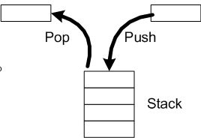
Stacks

Slide 41
Next Greater Element
Given an array, print the Next Greater Element (NGE) for every element. The Next greater Element for an element x is the first greater element on the right side of x in array. Elements for which no greater element exist, consider next greater element as -1.

Slide 42
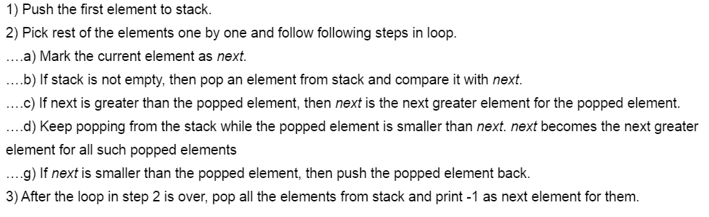

Slide 43
Implement Stack using Queues
We are given a Queue data structure that supports standard operations like enqueue() and dequeue(). We need to implement a Stack data structure using only instances of Queue.

Slide 44
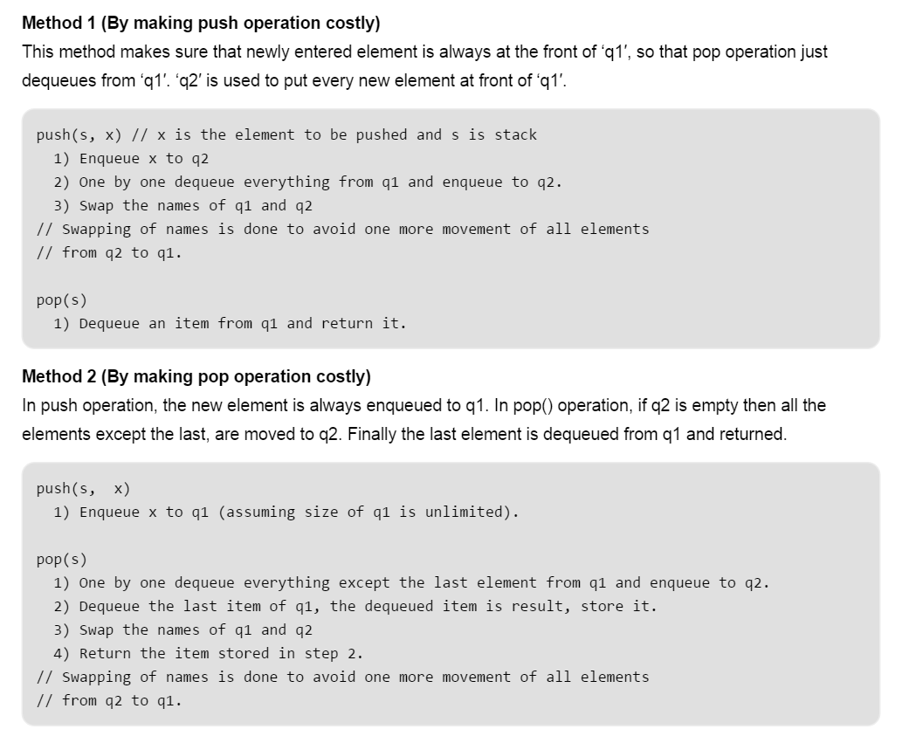

Slide 45
Design and Implement Special Stack Data Structure
Design a Data Structure SpecialStack that supports all the stack operations like push(), pop(), isEmpty(), isFull() and an additional operation getMin() which should return minimum element from the SpecialStack. All these operations of SpecialStack must be O(1).

Slide 46
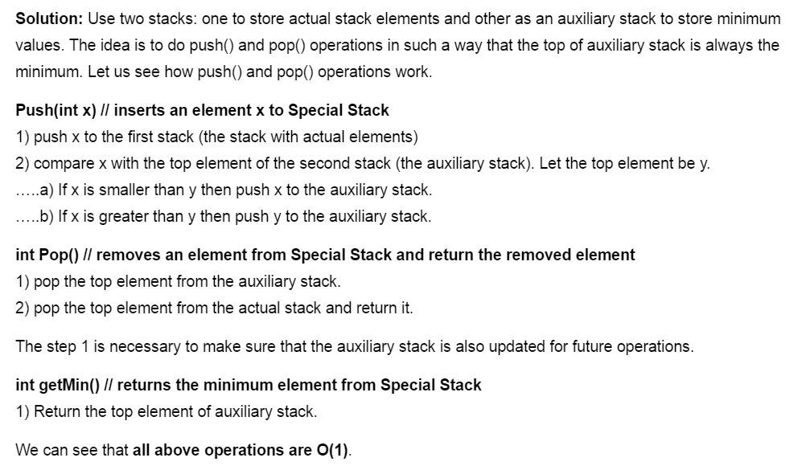

Slide 47
Similar Problem
Check for balanced parentheses in an expression: Given an expression string exp, write a program to examine whether the pairs and the orders of “{“,”}”,”(“,”)”,”[“,”]” are correct in exp.

Slide 48
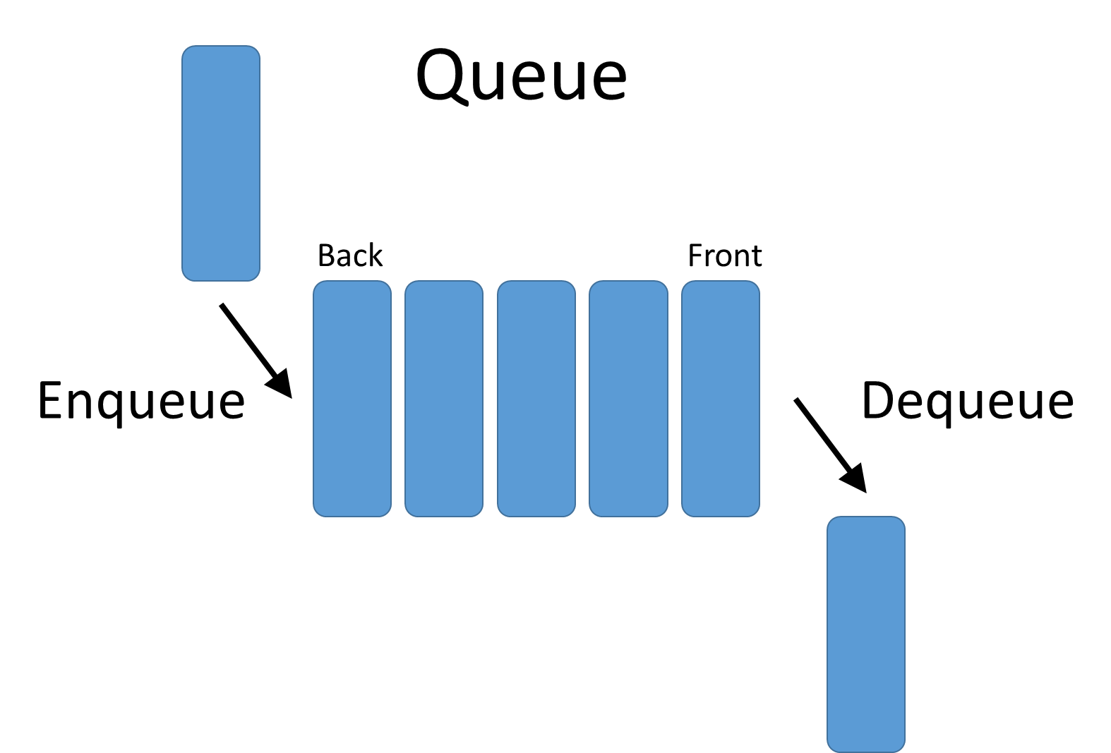
Queues

Slide 49
Implement Queue using Stacks
We are given a Stack data structure that supports standard operations like push() and pop(). We need to implement a Queue data structure using only instances of Queue.

Slide 50
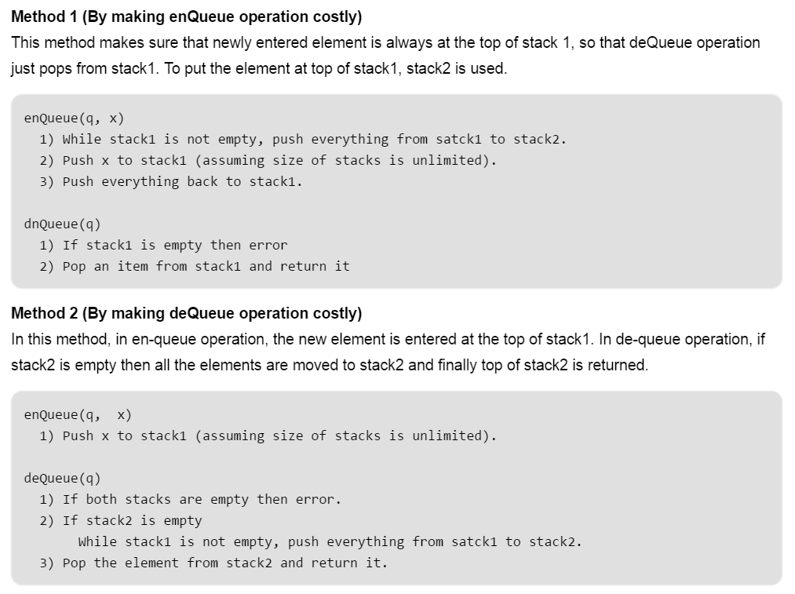

Slide 51
Maximum of all sub arrays of size k (Added a O(n) method)
Given an array and an integer k, find the maximum for each and every contiguous subarray of size k.
Example:
Input : arr[] = {1, 2, 3, 1, 4, 5, 2, 3, 6} k = 3 Output : 3 3 4 5 5 5 6

Slide 52
